Slide 1
Programming Through Java Code: 502
UNIT-I

Slide 2
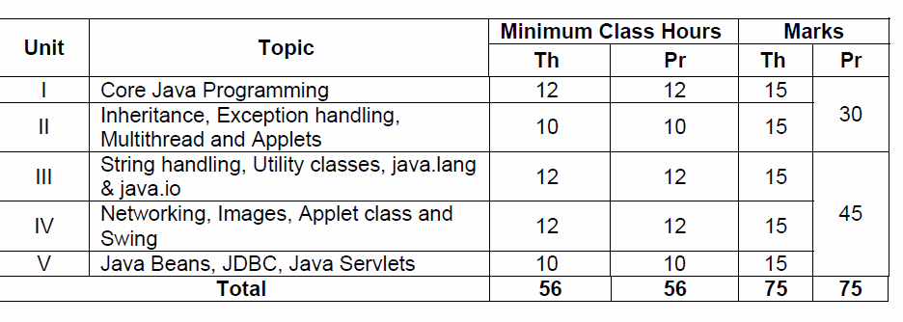
Overall Contents

Slide 3
Java Overview
James Gosling, Mike Sheridan, and Patrick Naughton initiated the Java language project in June 1991. The small team of sun engineers called Green Team.
Originally designed for small, embedded systems in electronic appliances like set-top boxes.
Firstly, it was called "Greentalk then Oak.
In 1995, Oak was renamed as "Java" because it was already a trademark by Oak Technologies.
James Gosling released in 1995 as core component of Sun Microsystems' Java platform (Java 1.0 [J2SE]).

Slide 4
Java Version History
There are many java versions that has been released. Current stable release of Java is Java SE 8.
JDK Alpha and Beta (1995)
JDK 1.0 (23rd Jan, 1996)
JDK 1.1 (19th Feb, 1997)
J2SE 1.2 (8th Dec, 1998)
J2SE 1.3 (8th May, 2000)
J2SE 1.4 (6th Feb, 2002)
J2SE 5.0 (30th Sep, 2004)
Java SE 6 (11th Dec, 2006)
Java SE 7 (28th July, 2011)
Java SE 8 (18th March, 2014)

Slide 5
Features of Java
There is given many features of java:
Object-Oriented
Platform independent
Secured Robust
Architecture neutral
Portable
Dynamic
Interpreted
High Performance
Multithreaded
Distributed

Slide 6
Object-oriented
Object-oriented means we organize our software as a combination of different types of objects that incorporates both data and behaviour.
Basic concepts of OOPs are: Object
Class
Inheritance
Polymorphism
Abstraction
Encapsulation

Slide 7
Platform Independent
A platform is the hardware or software environment in which a program runs.
Java provides software-based platform
Java code can be run on multiple platforms e.g., Windows, Linux, Sun Solaris, Mac/OS etc.
Java code is compiled by the compiler and converted into bytecode. This bytecode is a platform independent code because it can be run on multiple platforms i.e., Write Once and Run Anywhere(WORA)

Slide 8
Secured
Java is secured because:
No explicit pointer
Programs run inside virtual machine sandbox.
- Some security can also be provided by application developer through SSL, JAAS, cryptography etc.

Slide 9
Robust
Robust simply means strong.
Java uses strong memory management.
There is automatic garbage collection in java. There is exception handling and type checking mechanism in java.

Slide 10
Portable & Distributed
We may carry the java bytecode to any platform.
We can create distributed applications in java. RMI(Remote Method Invocation)and EJB(Enterprise JavaBeans) are used for creating distributed applications. We may access files by calling the methods from any machine on the internet.

Slide 11
Multi-threaded
A thread is like a separate program, executing concurrently. We can write Java programs that deal with many tasks at once by defining multiple threads.
The main advantage of multi-threading is that it shares the same memory. Threads are important for multi-media, Web applications etc.

Slide 12
Compilation and execution of a Java program
/* HelloWorld.java */
class HelloWorld
{
public static void main(String[] args)
{
System.out.println("Hello World!");
}
}

Slide 13
Compilation and execution of a Java program
During compilation phase Java compiler compiles the source code and generates bytecode. This intermediate bytecode is saved in form of a .class file.
In second phase, Java virtual machine (JVM) also called Java interpreter takes the .class as input and generates output by executing the bytecode.

Slide 14
JVM, JRE and JDK
Java Virtual Machine is a program that runs pre compiled Java programs, which mean JVM executes .class files (byte-code) and produces output.
The JVM performs following main tasks:
Loads code
Verifies code
Executes code
Provides runtime environment

Slide 15
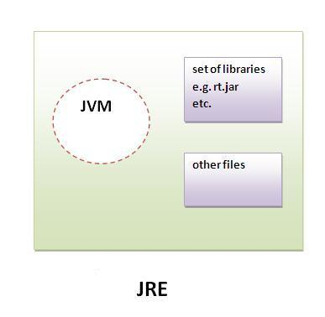
Java Runtime Environment(JRE)
JRE is an acronym for Java Runtime Environment. It is used to provide runtime environment.
It is the implementation of JVM. It physically exists.
It contains set of libraries + other files that JVM uses at runtime.

Slide 16
JDK
Java Development Kit is needed for developing Java applications. It is a bundle of software that is used to develop Java based applications. It includes the JRE, set of API classes, Java compiler, Webstart and additional files needed to write Java applets and applications.

Slide 17
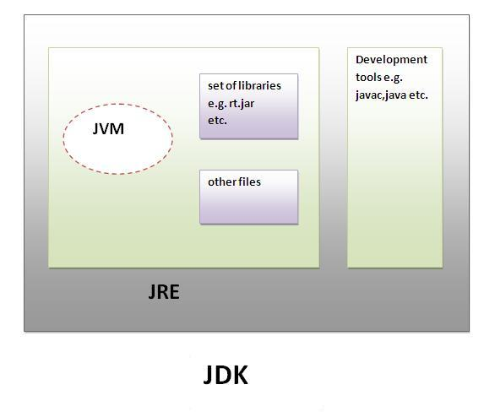
JDK

Slide 18
Java & Internet
An applet is a Java program that runs in a Web browser.
Applets are designed to be embedded within an HTML page.
When a user views an HTML page that contains an applet, the code for the applet is downloaded to the user's machine.
A JVM is required to view an applet. The JVM can be either a plug-in of the Web browser or a separate runtime environment.

Slide 19
Java & Internet
Portability - Since Internet is comprised of many different types of computers and operating systems, it is important for the programs to run on all these systems. Either we have to have a separate program for every operating system or write a portable (or platform independent) program like Java Applet which runs everywhere. This portability is achieved by using Byte code.

Slide 20
Java language fundamentals

Slide 21
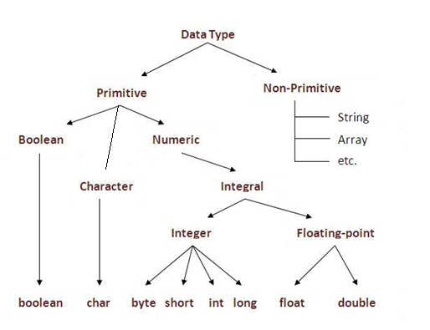
Data Types
In java, there are two types of data types -
primitive data types
non-primitive data types
Notes:
JAVA uses UNICODE system not ASCII code

Slide 22
The scope and lifetime of variable
A scope determines what objects are visible to other parts of your program. It also determines the lifetime of those objects.
We can declare variables within any block.
Block is begun with an opening curly brace and ended by a closing curly brace.
1 block equal to 1 new scope in Java thus each time you start a new block, you are creating a new scope.

Slide 23
Example
public class Main { public static void main(String args[])
{
int x; // known within main
x = 10;
if (x == 10) { // start new scope
int y = 20; // y is known only to this block // x and y both known here.
System.out.println("x and y: " + x + " " + y);
x = y + 2;
}
System.out.println("x is " + x);
}
}

Slide 24
Type conversion and casting
If the two types are compatible, then Java will perform the conversion automatically.
For example, assign an int value to a long variable.
For incompatible types we must use a cast.
Casting is an explicit conversion between incompatible types.

Slide 25
Java's Automatic Conversions
An automatic type conversion will be used if the following two conditions are met:
The two types are compatible.
The destination type is larger than the source type.

Slide 26
Examples
int type is always large enough to hold all valid byte values, so an automatic type conversion takes place.
public class Main { public static void main(String[] argv)
{
byte b = 10; int i = 0;
i = b;
System.out.println("b is " + b);
System.out.println("i is " + i);
}
} output: b is 10 i is 10

Slide 27
Casting
A cast is an explicit type conversion. It has this general form:
(target-type) value
target-type specifies the desired type.
The following code casts int type value to byte type value.
public class Main { public static void main(String[] argv)
{
int a = 1234; byte b;
b = (byte) a;
System.out.println("a is " + a);
System.out.println("b is " + b);
}
}

Slide 28
Loops
Java has very flexible three looping mechanisms.
while Loop
do...while Loop
for Loop
Enhanced for loop in Java (foreach):
for(declaration : expression)
{
//Statements
}

Slide 29
Example
public class Test
{
public static void main(String args[ ])
{
int [ ] numbers = {10, 20, 30, 40, 50};
for(int x : numbers )
{
System.out.print( x );
System.out.print(",");
}
System.out.print("\n");
String [] names ={"James", "Larry", "Tom", "Lacy"};
for( String name : names )
{
System.out.print( name );
System.out.print(",");
}
}
} This would produce the following result: 10,20,30,40,50, James,Larry,Tom,Lacy

Slide 30
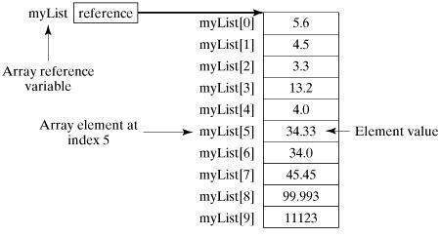
Arrays
Declaring Array Variables:
dataType[ ] arrVar; // preferred way. Or
dataType arrVar[ ]; // works but not preferred way.
Creating Arrays:
by using the new operator with the following syntax:
e.g., double[ ] myList = new double[10];

Slide 31
Passing Arrays to Methods
public static void printArray(int[ ] array)
{
for (int i = 0; i < array.length; i++)
{
System.out.print(array[i] + " ");
}
}

Slide 32
Returning an Array from a Method:
public static int [ ] reverse( int [ ] list)
{
int [ ] result = new int [ list.length ];
for (int i = 0, j = result.length - 1; i < list.length; i++, j--)
{
result[j] = list[ i ];
}
return result;
}

Slide 33
The Arrays Class
The java.util.Arrays class contains various static methods for sorting and searching arrays
public static int binarySearch(Object[] a, Object key)
public static boolean equals(long[] a, long[] a2)
public static void sort(Object[ ] a)
Object can be( Byte, Int , double, etc.)

Slide 34
Sort integer 1-Darray
Integer[] elevens = { 44, 22, 55, 11, 33, 66, 77 };
Arrays.sort(elevens);
System.out.println("increasing order : " + Arrays.toString(elevens));

Slide 35
Multidimensional array in java
Syntax
dataType[ ][ ] arrayRefVar; (or)
dataType arrayRefVar[ ][ ];
Example
int[ ][ ] a= new int[3][4]; //3 row and 3 column

Slide 36
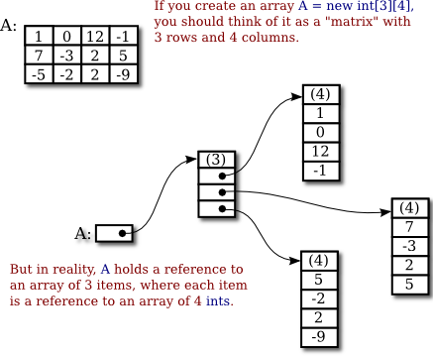
Illustration of 2D array

Slide 37
Sort 2-D array
?

Slide 38
Strings
public class StringDemo
{
public static void main(String args[ ])
{
char[ ] helloArray = { 'h', 'e', 'l', 'l', 'o', '.'};
String helloString = new String( helloArray ); System.out.println( helloString );
}
}

Slide 39
String Classs

Slide 40
Classes and Objects

Slide 41
Class
A class is a group of objects that has common properties.
A class in java can contain:
data member
method
constructor
block
class and interface
Syntax to declare a class:
class <class_name> {
data member;
method;
}

Slide 42
Example of Object and Class
class Rectangle{
int length;
int width;
void insert(int l,int w)
{
length=l;
width=w;
}
void calculateArea( ) { System.out.println( length*width ); }
public static void main (String args[ ]) {
Rectangle r1=new Rectangle( );
Rectangle r2=new Rectangle ( );
r1.insert(11,5);
r2.insert(3,15);
r1.calculateArea();
r2.calculateArea();
}
}
Output:55 45

Slide 43
Different ways to create an object in Java
There are many ways to create an object in java. They are:
By new keyword
By newInstance() method
By clone() method
By factory method etc.

Slide 44
Annonymous object
Annonymous simply means nameless. An object that have no reference is known as annonymous object.
If you have to use an object only once, annonymous object is a good approach.
e.g.,
Simple object instantiation is done: Sample s = new Sample(); Anonymous object instantiation: new Sample();

Slide 45
Example
class Calculation{
void fact(int n){
int fact=1;
for(int i=1;i<=n;i++){
fact=fact*i;
}
System.out.println("factorial is "+fact);
}
public static void main(String args[ ]) {
new Calculation().fact(5); //calling method with annonymous object
}
}

Slide 46
Access Modifiers
There are two types of modifiers in java: access modifiers and non-access modifiers.
The access modifiers in java specifies accessibility (scope) of a data member, method, constructor or class.
There are 4 types of java access modifiers:
private
default
protected
Public
There are many non-access modifiers such as static, abstract, synchronized, native, volatile, transient etc.

Slide 47
Access Modifiers
private access modifier : The private access modifier is accessible only within class.
Note: A class cannot be private or protected except nested class.
default access modifier: If you don't use any modifier, it is treated as default by default. The default modifier is accessible only within package.

Slide 48
//save by A.java
package pack;
class A{
void msg(){System.out.println("Hello");}
}
//save by B.java
package mypack;
import pack.*;
class B{
public static void main(String args[]){
A obj = new A();//Compile Time Error
obj.msg();//Compile Time Error
}
}
In the above example, the scope of class A and its method msg() is default so it cannot be accessed from outside the package

Slide 49
Access Modifiers
protected access modifier
The protected access modifier is accessible within package and outside the package but through inheritance only.
The protected access modifier can be applied on the data member and method. It can't be applied on the class.
[Further Reading Pages 138-140, complete Ref-&th Edtn]

Slide 50
//save by A.java
package pack;
public class A{
protected void msg() { System.out.println("Hello"); }
}
//save by B.java
package mypack;
import pack.*;
class B extends A{ // extends for inheritance
public static void main(String args[]){
B obj = new B();
obj.msg();
}
} Output:Hello

Slide 51
Method Overloading
If a class have multiple methods by same name but different parameters, it is known as Method Overloading.
Method overloading increases the readability of the program.
There are two ways to overload the method in java
By changing number of arguments
By changing the data type

Slide 52
Example
class Calculation {
void sum(int a,int b)
{ System.out.println(a+b);}
void sum(int a,int b,int c)
{ System.out.println(a+b+c); }
public static void main(String args[ ])
{
Calculation obj=new Calculation();
obj.sum(10,10,10);
obj.sum(20,20);
}
}

Slide 53
Constructor
Constructor in java is a special type of method that is used to initialize the object.
Java constructor is invoked at the time of object creation. It constructs the values i.e. provides data for the object that is why it is known as constructor.
There are basically two rules defined for the constructor.
Constructor name must be same as its class name
Constructor must have no explicit return type

Slide 54
Constructor
There are two types of constructors:
Default constructor (no-arg constructor)
Parameterized constructor

Slide 55
Example of default constructor
class Bike1
{
Bike1()
{
System.out.println("Bike is created");
}
public static void main(String args[ ])
{
Bike1 b=new Bike1();
}
}

Slide 56
parameterized constructor
class Student {
int id;
String name;
Student(int i, String n) {
id = i;
name = n;
}
void display() { System.out.println (id+" "+name); }
public static void main(String args[]){
Student s1 = new Student(111,"Karan");
Student s2 = new Student(222,"Aryan");
s1.display();
s2.display();
}
}

Slide 57
Constructor Overloading
Constructor overloading is a technique in Java in which a class can have any number of constructors that differ in parameter lists.
The compiler differentiates these constructors by taking into account the number of parameters in the list and their type.

Slide 58
class Student{
int id;
String name;
int age;
Student(int i,String n) {
id = i;
name = n;
}
Student (int i, String n, int a) {
id = i;
name = n;
age=a;
}
void display() { System.out.println(id+" "+name+" "+age); }
public static void main(String args[]){
Student5 s1 = new Student(111,"Karan");
Student5 s2 = new Student(222,"Aryan",25);
s1.display();
s2.display();
}
}

Slide 59
Copy Constructor
We can copy the values of one object to another like copy constructor in C++

Slide 60
class Student{
int id;
String name;
Student (int i, String n){
id = i;
name = n;
}
Student (Student s){
id = s.id;
name =s.name;
}
void display() { System.out.println(id+" "+name); }
public static void main(String args[]){
Student s1 = new Student(111,"Karan");
Student s2 = new Student(s1);
s1.display();
s2.display();
}
}

Slide 61
this keyword
There can be a lot of usage of java this keyword. In java, this is a reference variable that refers to the current object.
Usage of java this keyword
this keyword can be used to refer current class instance variable.
this() can be used to call one constructor from another.
this keyword can be used to invoke current class method (implicitly)
this can be passed as an argument in the method call.
this keyword can also be used to return the current class instance.

Slide 62
Example
public class Student {
int id;
String name;
Student(int id,String name){
id = id;
name = name;
}
void display(){System.out.println(id+" "+name);}
public static void main(String[] args) {
Student s1 = new Student(111,"Karan");
Student s2 = new Student(222,"Aryan");
s1.display();
s2.display();
}
} It will output :: NULL NULL

Slide 63
Solution
public class Student {
int id;
String name;
Student(int id,String name){
this.id = id;
this.name = name;
}
void display(){System.out.println(id+" "+name);}
public static void main(String[] args) {
Student s1 = new Student(111,"Karan");
Student s2 = new Student(222,"Aryan");
s1.display();
s2.display();
}
}

Slide 64
this() used to call one constructor from another
class Student { String name; int rollNumber; int marks1, marks2; public Student ( String name, String rollNumber, int marks1, int marks2 ) { this.name = name; this. rollNumber = rollNumber; this.marks1= marks1; this.marks2 = marks2; } public Student ( String name, int rollNumber ) { this ( name, rollNumber, -1,-1 ); } public Student ( String rollNumber ) { this ( null, rollNumber ); } }

Slide 65
this() keyword can be used to invoke current class method
class S{
void m() {
System.out.println("method is invoked");
}
void n(){
this.m(); //no need because compiler does it for you.
}
void p(){
n(); //complier will add this to invoke n() method as this.n()
}
public static void main(String args[]){
S s1 = new S();
s1.p();
}
}

Slide 66
this keyword can be passed as an argument in the method.
It is mainly used in the event handling
class Stud{
void m(Stud obj){
System.out.println("method is invoked");
}
void p() {
m(this);
}
public static void main(String args[]){
Stud s1 = new Stud();
s1.p();
}
}

Slide 67
this keyword can be used to return current class instance
In such case, return type of the method must be the class type (non-primitive).
class test {
test getA() {
System.out.println("Hello java");
return this;
}
}
class Test1 {
public static void main(String args[]) {
new test().getA();
}
}

Slide 68
Static and final keyword
The static keyword in java is used for memory management mainly. We can apply java static keyword with variables, methods, blocks and nested class.
The static can be:
variable (also known as class variable)
method (also known as class method)
block
nested class

Slide 69
Java static variable
If you declare any variable as static, it is known static variable.
The static variable can be used to refer the common property of all objects (that is not unique for each object) e.g. company name of employees, college name of students etc.
The static variable gets memory only once in class area at the time of class loading.
It makes your program memory efficient

Slide 70
Java static method
If you apply static keyword with any method, it is known as static method.
A static method belongs to the class rather than object of a class.
A static method can be invoked without the need for creating an instance of a class.
static method can access static data member and can change the value of it.

Slide 71
class Student{
int rollno;
String name;
static String college = "ITS";
static void change()
{ college = "BBDIT"; }
Student(int r, String n)
{ rollno = r; name = n; }
void display (){System.out.println(rollno+" "+name+" "+college);}
public static void main(String args[]) {
Student9.change();
Student9 s1 = new Student9 (111,"Karan");
Student9 s2 = new Student9 (222,"Aryan");
s1.display();
s2.display();
}
}

Slide 72
Static
Restrictions for static method
There are two main restrictions for the static method. They are: The static method can not use non static data member or call non-static method directly.
this and super cannot be used in static context.
e.g., class A { int a=40; //non static
public static void main(String args[])
{
System.out.println(a);
}
}

Slide 73
Question
Why java main method is static?
Ans: because object is not required to call static method if it were non-static method, jvm create object first then call main() method that will lead the problem of extra memory allocation.

Slide 74
Java static block
Is used to initialize the static data member.
It is executed before main method at the time of classloading.
e.g., class A2{
static{ System.out.println("static block is invoked"); }
public static void main(String args[])
{ System.out.println("Hello main");
}
}

Slide 75
Final Keyword
The final keyword in java is used to restrict the user. The java final keyword can be used in many context. Final can be:
variable
method
class

Slide 76
Java final variable
If you make any variable as final, you cannot change the value of final variable(It will be constant).
e.g., There is a final variable speedlimit, we are going to change the value of this variable, but It can't be changed because final variable once assigned a value can never be changed.
class Bike{
final int speedlimit=90; //final variable
void run(){
speedlimit=400;
}
public static void main(String args[]){
Bike obj=new Bike ();
obj.run();
}
}//end of class

Slide 77
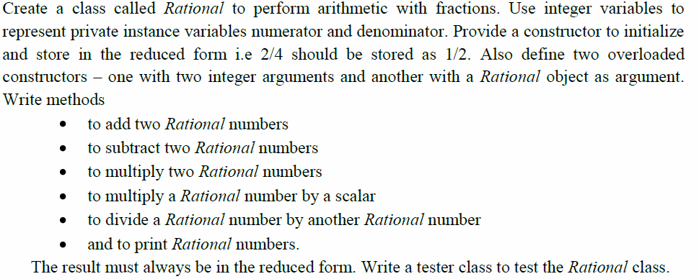
Assignment

Slide 78
Returning the Object From Method
Method can return any type of data, including class types that you create.
e.g.,, in the following program, the updateSalary() method returns an object.

Slide 79
class Employee{
double salary;
Employee (double salary)
{
this.salary = salary;
}
Employee updateSalary (double salary)
{
Employee emp= new Employee( this.salary + salary );
return emp;
}
double getSalary()
{
return this.salary;
}
}

Slide 80
class ReturnObject{
public static void main(String args[ ])
{
Employee e1 = new Employee(34029.48);
Employee e2;
e2= e1.updateSalary(6295.28);
System.out.println("Salary of e1 is: "+e1.getSalary());
System.out.println("Salary of e2 is: "+e2.getSalary());
}
}

Slide 81
Nested classes
Java inner class or nested class is a class i.e., declared inside the class.
We use inner classes to logically group classes in one place so that it can be more readable and maintainable.
Additionally, it can access all the members of outer class including private data members and methods.

Slide 82
Example
class Java_Outer_class{
//code
class Java_Inner_class{
//code
}
}

Slide 83
Example
class OuterClass
{
private int privInt = 10;
class InnerClass
{
public void accessOuter()
{
System.out.println("The outer class's private variable is: " + privInt);
}
}
}

Slide 84
Example(To generate object of inner class inside outside class)
class OuterClass
{
private int privInt = 10;
public void createInnerClass()
{
InnerClass in = new InnerClass();
in.accessOuter();
}
class InnerClass
{
public void accessOuter()
{
System.out.println("The outer class's private variable is: " + privInt);
}
}
}

Slide 85
Advantage of java inner classes
Advantages of inner classes in java. They are as follows:
1) Nested classes represent a special type of relationship i.e., it can access all the members (data members and methods) of outer class including private.
2) Nested classes are used to develop more readable and maintainable code because it logically group classes and interfaces in one place only.

Slide 86
Types of Nested classes
Nested classes can be either static or non-static
Non-static nested classes are more formally known as inner classes. So, think of nested classes as a big container with 2 smaller boxes inside – 1 box is for static nested classes, and another box is for inner classes (also known as non-static nested classes).

Slide 87
Static nested class
A static class i.e., created inside a class is called static nested class in java. It cannot access non-static data members and methods. It can be accessed by outer class name.
It can access static data members of outer class including private.
Static nested class cannot access non-static (instance) data member or method.

Slide 88
Example
class TestOuter
{
static int data=30;
static class Inner {
static void msg()
{
System.out.println("data is “ +data);
}
public static void main(String args[])
{
TestOuter.Inner.msg(); //no need to create the instance
}
}

Slide 89
Garbage Collections
Garbage means unreferenced objects.
Garbage Collection is a process of reclaiming the runtime unused memory automatically. In other words, it is a way to destroy the unused objects.
free() function in C language and delete() in C++. But, in java it is performed automatically. So, java provides better memory management.

Slide 90
Garbage Collections
Advantage of Garbage Collection:
It makes java memory efficient because garbage collector removes the unreferenced objects from heap memory.
It is automatically done by the garbage collector(a part of JVM) so we don't need to make extra efforts.

Slide 91
How can an object be unreferenced?
There are many ways:
By nulling the reference
By assigning a reference to another
By annonymous object etc.

Slide 92
Garbage Collections
Consider the situation
If an object is holding some non-Java resource such as a file handle or character font, then before an object is destroyed it is necessary to release those resources.
finalize() method:
The finalize() method is invoked each time before the object is garbage collected. This method can be used to perform cleanup processing.
protected void finalize() { }
Inside the finalize( ) method, specify those actions that must be performed before an object is destroyed.

Slide 93
Garbage Collections
gc() method:
The gc() method is used to invoke the garbage collector explicitly.
The gc() is found in System and Runtime classes.
public static void gc(){}
NOTE: Garbage collection is performed by a daemon thread called Garbage Collector(GC). This thread calls the finalize() method before object is garbage collected.

Slide 94
Example
public class Test {
public static void main(String[ ] args)
{
Test t = new Test();
t = null;
System.out.println("Garbage …..");
System.gc();
}
Protected void finalize()
{
System.out.println("Garbage Collected");
}
}

Slide 95
Command Line Arguments
The java command-line argument is an argument i.e. passed at the time of running the java program.
The arguments passed from the console can be received in the java program and it can be used as an input.

Slide 96
Command Line Arguments
class CommandLineExample{
public static void main(String args[]){
System.out.println("Your first argument is: "+args[0]);
}
}
compile by > javac CommandLineExample.java
run by > java CommandLineExample Helloss
Output: Your first argument is: Helloss

